Slide 1
Linux Administration
Week 11 & 12
Containers and container management

Slide 2
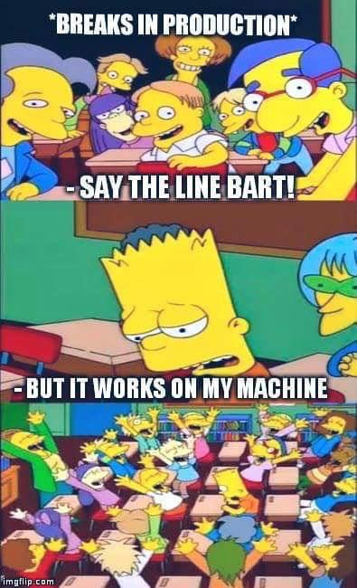
What is a container?
Virtual isolated place on your machine
Example: Think of shipping, standardized containers to ship goods makes transport easier and cheaper. In this case you don't ship the OS & the software, you only need to ship the code and the dependencies.
Every time you use Google (Gmail, search, etc) You are using a container

Slide 3
Why are containers useful?
Developers will use them to know their software will run regardless of where it's sent.
Microservices (Instead of a monolithic application) break applications into small parts so many teams can easily work on pieces of a whole project and then put them together quickly
Guaranteed reproducibility because you have your container already set up to spec
Isolation, by keeping your applications separated (Database, web server, front end etc.) you can save yourself from conflicts and dependency issues
Repository gives us well maintained containers pre-made for us to use
Easily disposable and quick to boot and stop, in case something goes wrong, containers are cheap and not resource heavy to make and discard

Slide 4

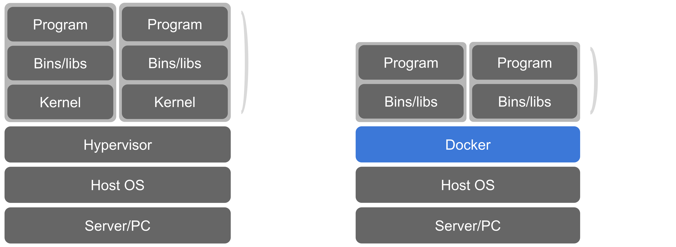
Containers vs Virtual machines
Containers virtualize the OS (In this example it's Docker)
Virtual Machines virtualize the hardware

Slide 5
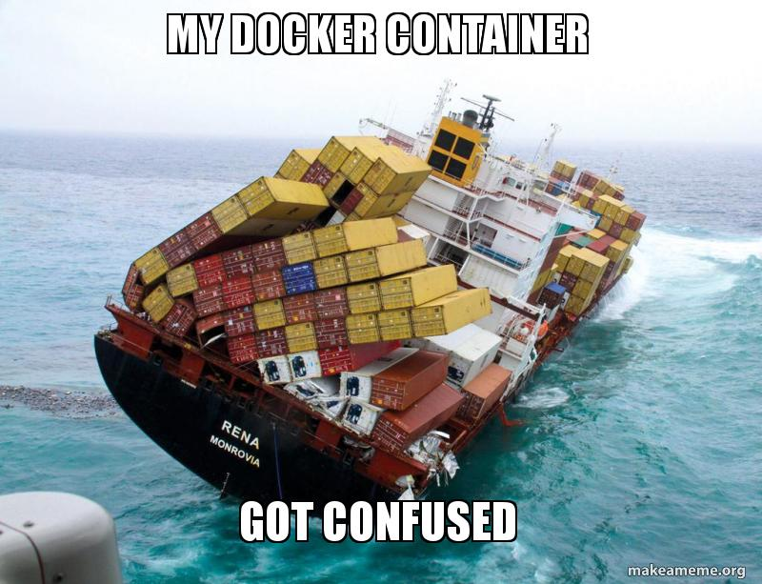
Container options 2022 by Market Share
Docker is the most popular with 81% of the market
Kubernetes with 13% market share
CoreOS, Apache Mesos, VMWare Tanzu and others have less then 2% market share per technology
https://web.archive.org/web/20220725155332/https://www.slintel.com/tech/containerization/docker-market-share

Slide 6
Container image management options
Container Registry is a service to hold and distribute container images
Can be public, private or third party
Examples include Docker Hub, AWS container registry, Google Container Registry, or self-hosted
Container repository is a collection of related images with the same name and different tags (Providing different versions of an application)
Examples:
Python Repository https://hub.docker.com/_/python?tab=tags
Apache https://hub.docker.com/_/httpd

Slide 7
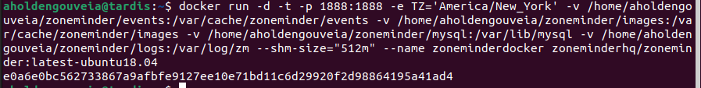
Docker
What is Docker?
Container Software
A way to run applications, technically open source but moving more closed.
Everything is considered encapsulated (stay in their own area)
Docker Engine vs Docker Desktop
Docker Engine – Create an run pieces of docker to create containers
Docker Desktop – GUI options and interacts with containers for windows people
How to Use Docker for pre-built containers
Install Docker on Linux box
Run command to start container build (Example below for ZoneMinder)

Slide 8
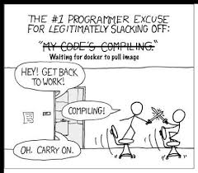
Activity
https://docker-curriculum.com/
Run through this tutorial on one of your servers

Slide 9
Container Management
This is when you organize, add or replace large numbers of containers. Also referred to as container orchestration engines
Useful for scheduling functions, distributing containers among pooled resources, easy health checks, load balancing and high availability
Examples
Kubernetes
Docker Swarm
Popular because it's native to docker. YAML based deployment. Doesn't do load balancing or auto-scaling by itself
Mesosphere
Distributed Approach. Uses multiple masters and uses Zookeeper to keep track of the cluster. Highly scalable (tens of thousands of nodes) used by Twitter, Yelp and eBay

Slide 10
Kubernetes
Also referred to as K8
Open source
Started by Google, Still used as it's Container as a Service (CaaS). Used and developed by them because of their production use of containers.
Runs some of the largest software services by scale. Users include Google, Spotify, Bose, CapitalOne, Comcast, ebay, IBM, Pinterest, Pokemon Go and more https://kubernetes.io/case-studies/
Currently the most popular option.
YAML based deployment.
Uses pods, groups of containers scheduled together to make a single service

Slide 11

Kubernetes: How and why do we use it?
What is Kubernetes?
Think of Kubernetes like a magic Robot that helps us build the boxes, so instead of building the boxes ourselves (Docker) we ask the robot to build it for us. The Magic robot also helps us manage our little boxes. I like to call the Robot Mechi :)
What is Yaml?
Human Readable data-serialization Language
YAML ain't Markup Language
How is this different then Docker?
If Docker allows us to build little boxes, Kubernetes is a magic robot that builds boxes based on recipes we give it instead of doing it ourselves.

Slide 12
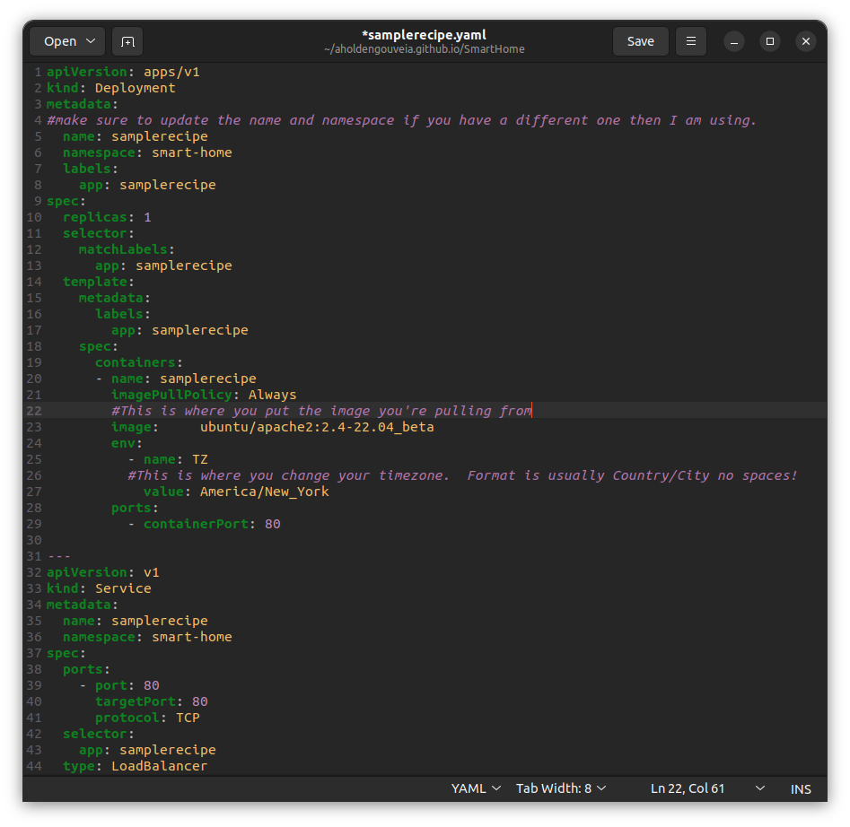
Kubernetes continues
Nodes – Computer we're running Kubernetes on
Control Plane – How we manage the boxes
Pods – Wrapper around the box
Namespace – A way to isolate groups, resources must be uniquely named within a namespace but not everywhere
Think of namespace like the name of a ship, the boxes that ship is bringing around is our containers
YAML is used to write the recipes the magic robot follows to make our boxes.

Slide 13
Kubectl
What is kubectl
A way to interact with the Kubernetes cluster from any computer
Can be run on your local machine to talk to Mechi on a server elsewhere.
Allows us to interact with the little boxes we've created
How to use kubectl
Install on your machine
Create a folder on your machine and go to it, this is where your files will live.
If you haven't already made a namespace that's first, then we create the boxes in the namespace.
Then we apply the yaml files, which is like saying "Mechi please go make a box from this recipe for me, thank you."
Examples of use can be found at: https://www.aholdengouveia.name/SmartHome/Virtualizationsetup.html

Slide 14
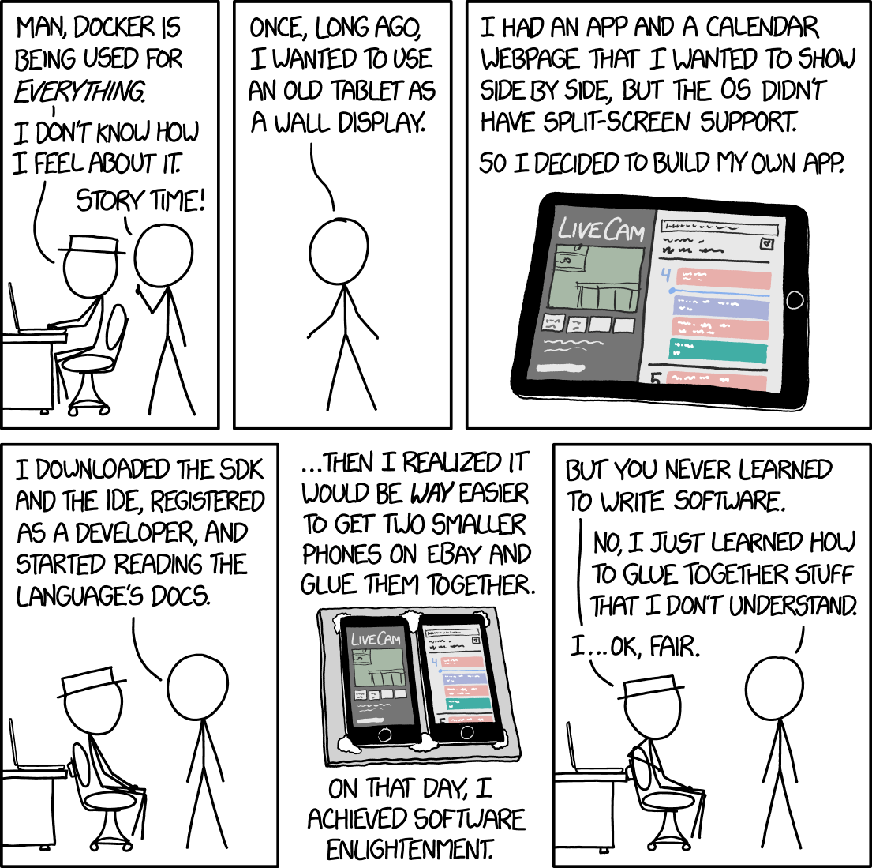
Activity
https://kubernetes.io/docs/tutorials/
Go through the tutorial for Kubernetes Basics.
Try and install an Apache container (or other container of your choice like ZoneMinder or HomeAssistant) using Docker OR Kubernetes on ONE of your servers. You can follow the instructions here: https://www.aholdengouveia.name/SmartHome/Virtualizationsetup.html

Slide 15
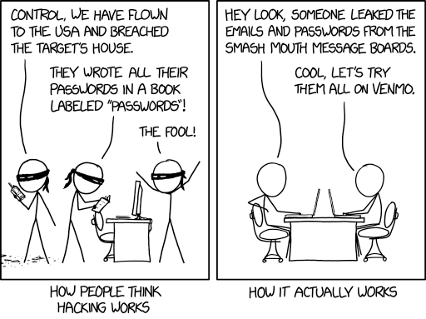
Kubernetes: Vulnerabilities
Increased attack service, each container might have different vulnerabilities to exploit.
Because Kubernetes can be difficult to configure right, it's easy to leave holes
Services like Shodan make it easy to find places to attack. For example, port 2379 is indexed by Shodan, etcd which Kubernetes uses as it's cluster database listens on port 2379
Tesla exposed part of the dashboard for their main Kubernetes API to the internet without authentication by accident
A compromised container = compromised cluster. It's turtles all the way down

